Slide 1
Introduction to Astronomy

Slide 2
Astronomy
Being the oldest natural science, Astronomy encompasses the study of a multitude of objects and phenomena, all of which grouped into their own branches.
Positional Astronomy
Celestial Mechanics
Optics
Spectroscopy
Cosmology
Astrobiology

Slide 3
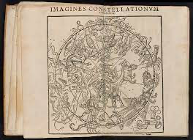
Astronomy vs Astrology
Not too long ago, the study of Astronomy was almost indistinguishable from Astrology
Now, one is a branch of science, the other fortune telling

Slide 4
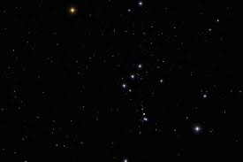
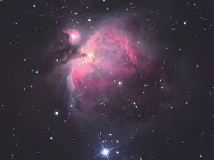
The Night Sky
What can you see?

Slide 5
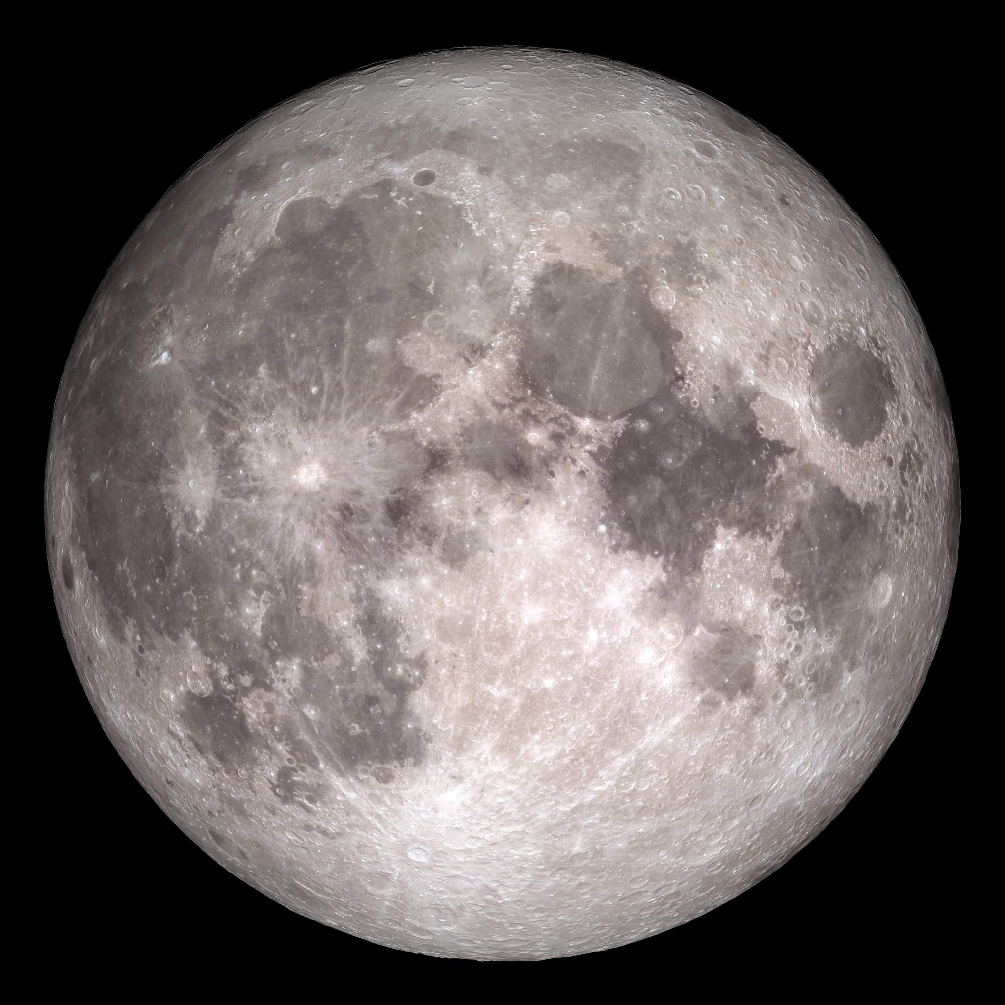

Objects in the Night Sky
What can you see with your naked eyes
The moon
Stars and planets
Clouds
Throughout the night, does the objects in the Night Sky move?

Slide 6
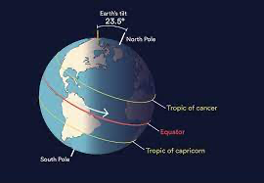
Rotation of the earth
The earth rotates, causing objects to rise and set
Which direction does the earth rotate in?

Slide 7
Rotation of the earth
Earth’s axial tilt is what causes seasons, and changes in the night sky throughout the year

Slide 8
Rotation of the earth
Tidal forces from Moon have slowed the earth’s rotation
Precession also changes the axial tilt

Slide 9
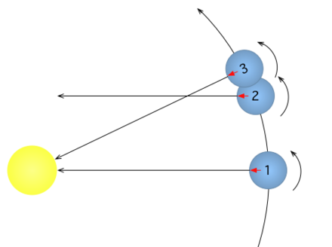
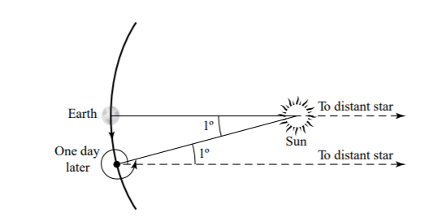
Sidereal vs Solar day
There are 2 definitions of a day
A sidereal day is where the earth rotates 360 degrees
A solar day is where the same point faces the sun again

Slide 10
How do we find something in the sky?
Angles are used for positioning of stars and other objects in the night sky

Slide 11
The Celestial Sphere

Slide 12
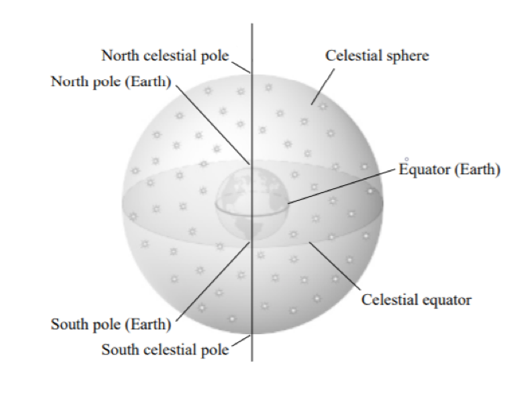
What is the Celestial Sphere
Abstract Sphere of arbitrary radius; tool of astronomy used to represent objects in the night sky.
Earth rotates in the center with celestial
objects fixed on the surface.
Earth rotates Eastwards or
Counterclockwise looking downwards to
North
Better way of representing position of
stars than as starhopping instructions

Slide 13
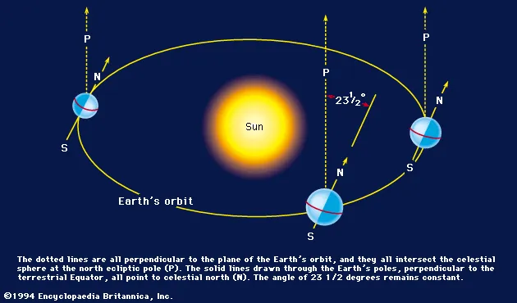
The Ecliptic and the Equinoxes
Earth’s orbital axis isn’t perpendicular to rotational axis
Sun’s distance from equator changes with Earth’s position
in orbit
Sun’s path (ecliptic) crosses equator twice per orbit
(during March and September)
Intersection points in celestial sphere are
called equinoxes
(Often confused with the other equinoxes
which are points in time)

Slide 14
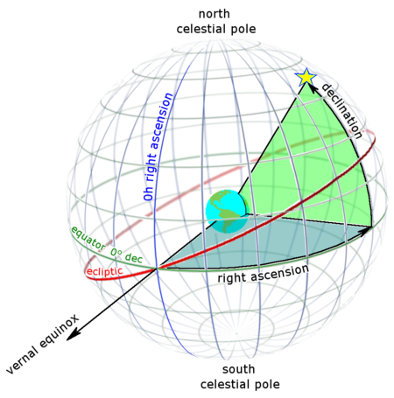
Celestial Coordinates (equitorial)
Positions of stars in celestial sphere defined by Right Ascension and Declination
Right Ascension (measured in time) : Angular distance between March Equinox and celestial object, in anti-clockwise direction, when viewing down on North (eastward)
Declination (Measured in degrees): Shortest angular distance northwards between star and celestial equator
Hour Angle (Measured in whatever) :
Specific to position on Earth and time; defined as angular distance between plane perpendicular to surface of viewer and plane of star perpendicular to equator

Slide 15
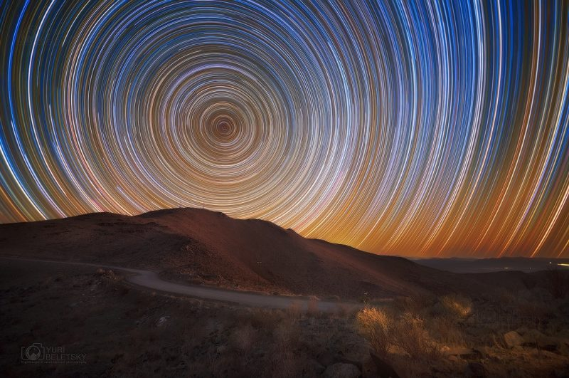
Visibility of stars
At Northern Hemisphere: Stars with declination between 90° and -(90-φ) will be visible and stars with declination greater than 90° - φ do not set
At Southern Hemisphere (φ is negative): Stars with declination between -90° and
(90° + φ) will be visible and stars with declination less than 90° + φ do not set
At Equator: All stars will be visible and no stars are circumpolar

Slide 16
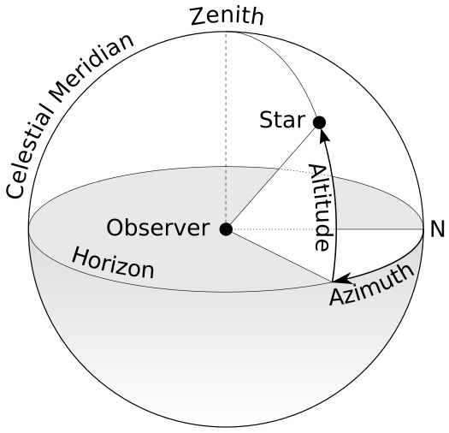
The other celestial coord system (Alt-Azi)
Position of celestial objects dependant on observer
Azimuth: Eastwardness of celestial object from North direction
Altitude: Elevation between object and horizon
Zenith: up
Celestial Meridian: Circle (check diagram)

